Slide 1
ASX Lit Market Share - Breakdown

Slide 2
The Aim
Identify the relationship of various Equities Cash Market elements with the ASX Lit Market Share.
Determine whether variables which we do not actively monitor have significant impacts on the ASX Lit market share.
Develop new insights into the non – existent, direct or inverse relationship of these variables with the ASX Lit Market Share.
As a by-product, see if there are any interesting relationships amongst these independent variables we do not actively monitor.

Slide 3
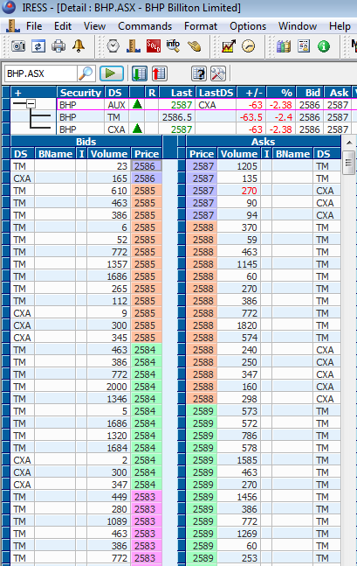
Variables
Dependent Variables
ASX Lit Market Share
Independent Variables
20 day SPI Realised Vol
ASX Lit Share 20 day MA
Sweep Value Traded - % of Lit Market
ASX-CXA Spread Differential.
Off Market Trading Activity
Index Rebalances
Sensitive Announcements
14 Day Average No. Customer Meetings
SPI Volume

Slide 4
View of the Raw Data
Statistic | ASX Lit Share | 20-Day Realised SPI Vol | ASX Lit Share (20 MA) | Spread Differential | %Sweep of Lit | Trade Registration | Index Rebalance | Sensitive Announcments | SPI Volume
count | 547 | 547 | 547 | 547 | 547 | 547 | 547 | 547 | 547
mean | 89.89% | 15.15% | 89.92% | -4.829 | 19.28% | 575,869,315 | 0.04 | 213 | 44,505
std | 1.57% | 4.76% | 1.18% | 2.260 | 7.92% | 329,735,064 | 0.20 | 192 | 51,097
min | 84.74% | 6.05% | 87.54% | -25.274 | 3.22% | 39,148,230 | 0.00 | 40 | 10,702
25% | 88.73% | 12.10% | 89.05% | -5.630 | 13.73% | 407,326,077 | 0.00 | 143 | 26,695
50% | 89.69% | 14.45% | 89.80% | -4.766 | 19.79% | 519,934,699 | 0.00 | 170 | 32,555
75% | 90.93% | 17.74% | 90.64% | -3.742 | 25.17% | 656,743,637 | 0.00 | 213 | 41,220
max | 95.09% | 28.86% | 93.19% | 0.060 | 35.61% | 5,267,017,018 | 1.00 | 1,721 | 484,488

Slide 5
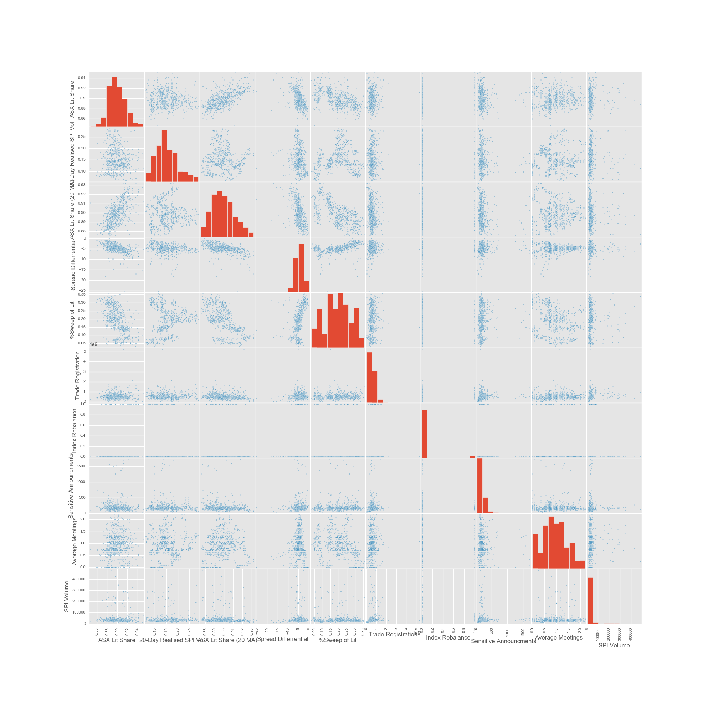

Slide 6
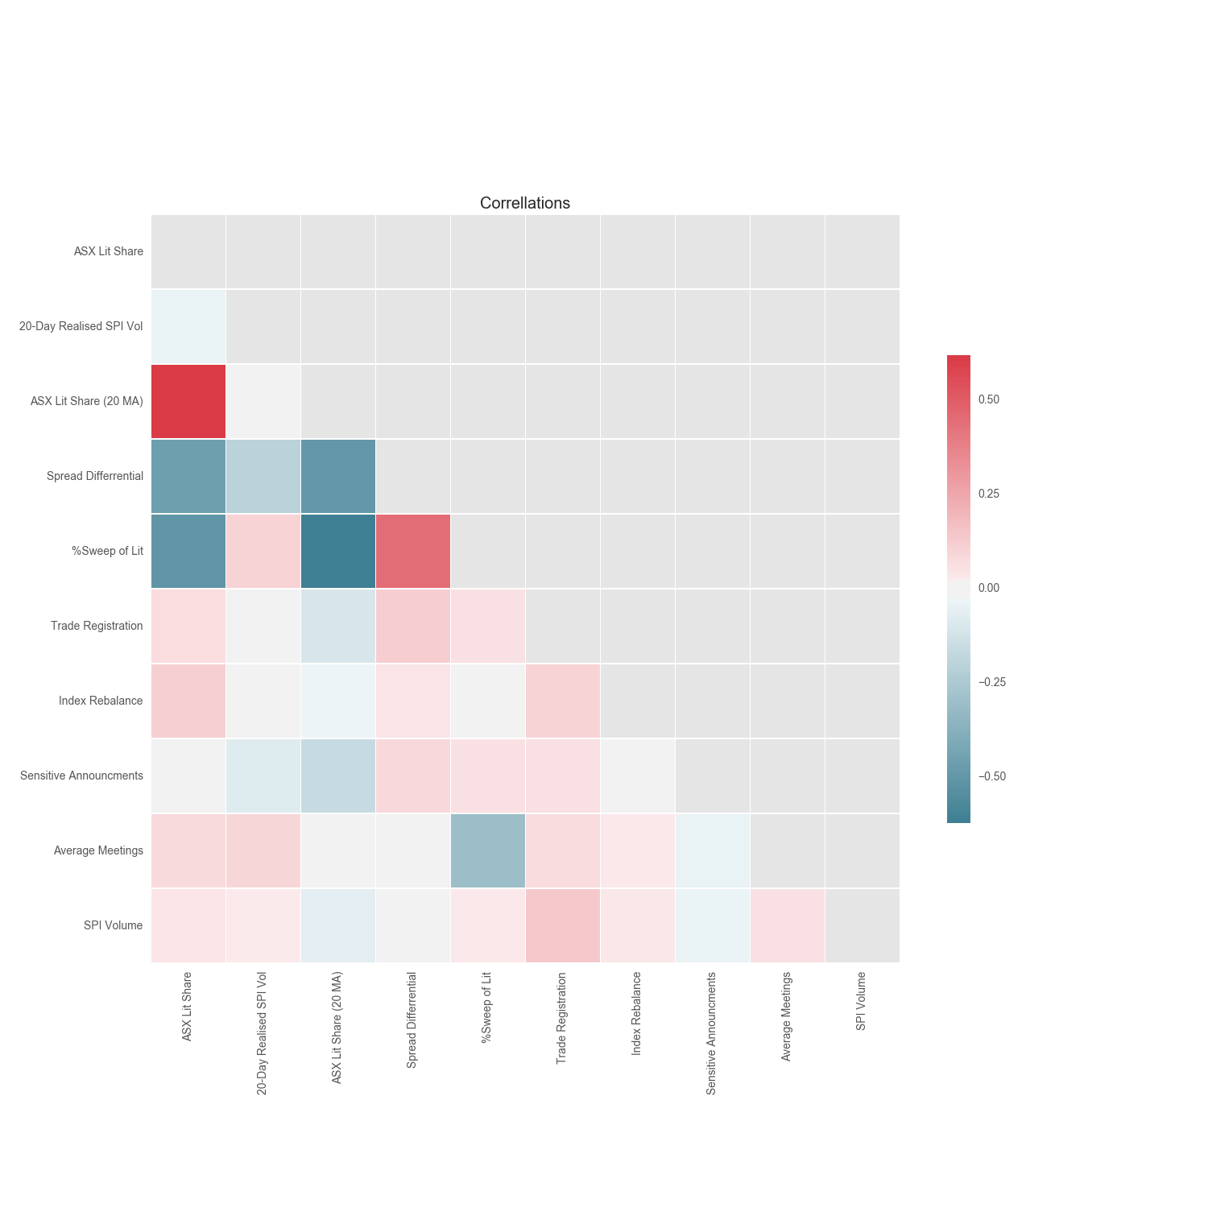
Correllations – Heatmap

Slide 7
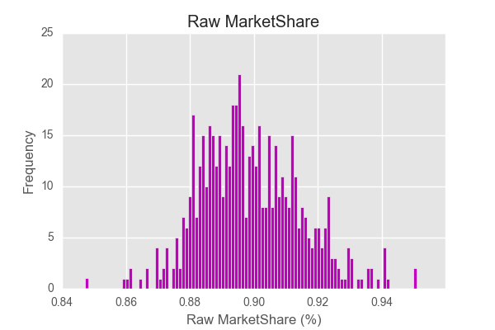
Histogram of the Dep. Variable

Slide 8
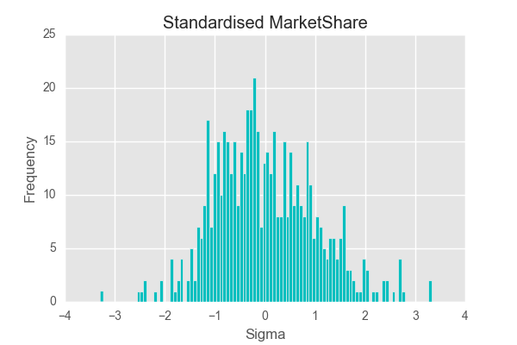
Histogram of the Standardised Dep. Variable
SciKitLearn : Std_scale = preprocessing.StandardScaler().fit(df)

Slide 9
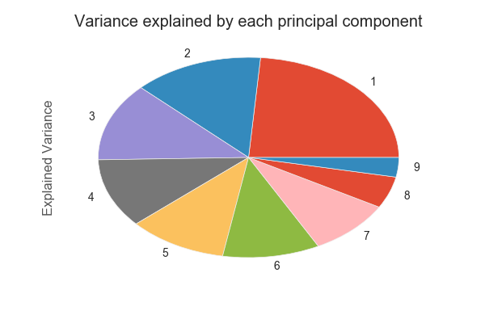
Principal Components Analysis (PCA)

Slide 10
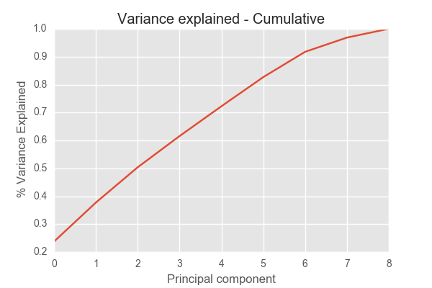
PCA – Variance Explained

Slide 11
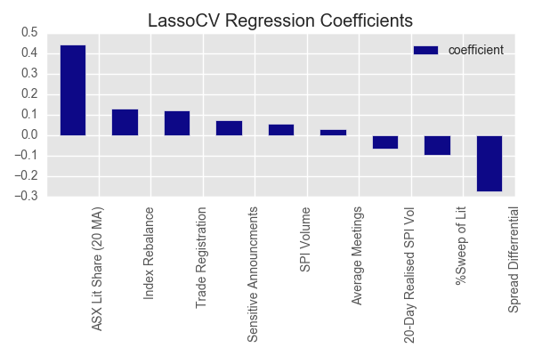
Lasso Regression – With Cross Validation (CV = 100)
R Squared : 0.54

Slide 12
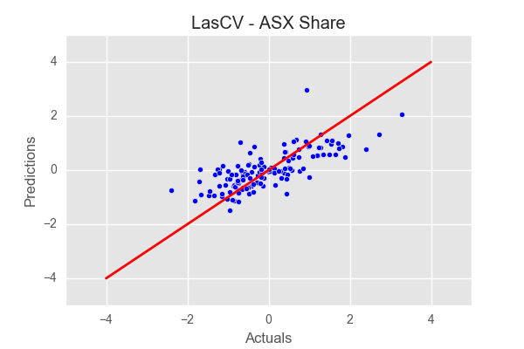
LassoCV – Model Quality
Scatter Line (Las CV) : Predictions = 0.51*(Actuals) + 0.03

Slide 13
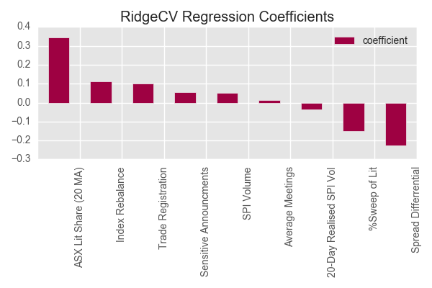
Ridge Regression – With Cross Validation (CV = 100)
R Squared : 0.52

Slide 14
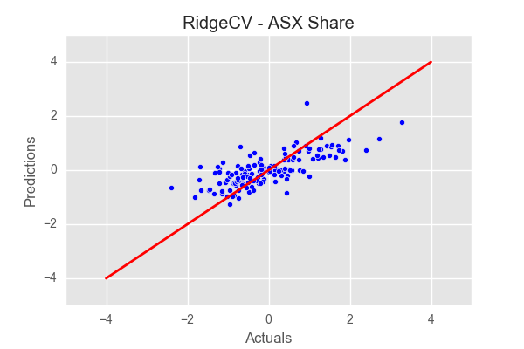
RidgeCV – Model Quality
Scatter Line (Ridge CV) : Predictions = 0.44*(Actuals) + 0.03

Slide 15
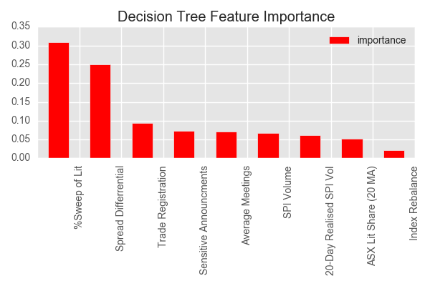
Decision Tree Approach

Slide 16
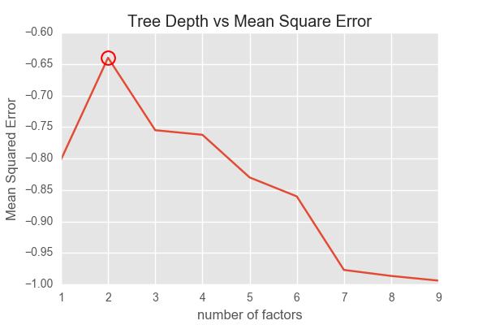
Decision Tree – Ideal No. Parameters

Slide 17
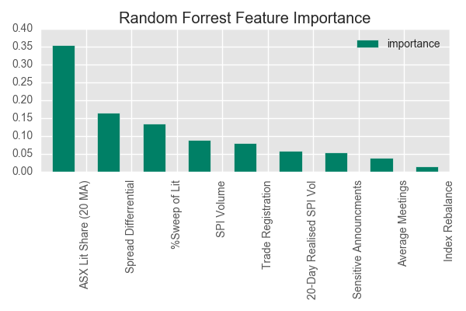
Random Forrest Approach (N_Estimates = 1000)

Slide 18
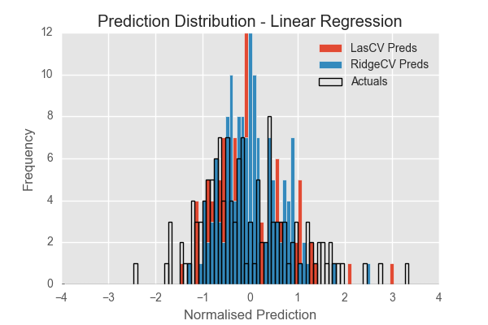
Regression - Predictive Power

Slide 19
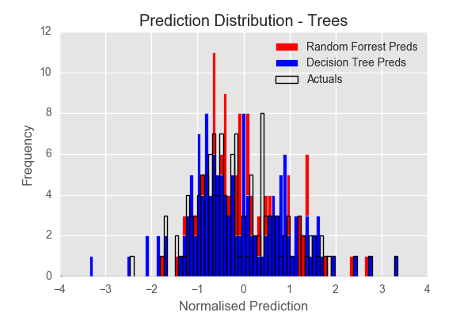
Decision Tree - Predictive Power

Slide 20
Key Insights
All factors do have importance in the regression (as determined by
PCA & LassoCV).
The 20 day Lit Share MA, Spread Differential & (to a lesser extent) the
% sweep of lit market make up >50% of the feature importance & have relatively
large regression coefficients.
(Surprise!) We were hoping that Sweep % of Lit would have a greater, positive impact
On the market share.
(Surprise!) We thought market volatility would have a greater, positive
impact on the market share.
Some non-regression related insights-
There is a positive correlation between the spread differential and Sweep.
As volatility goes up, the spread differential becomes more negative.
ALWAYS wear your business hat when looking at these numbers!!

Slide 21
Overall Experience
Where to from here –
Well received by the Trade Execution team. We will apply the same techniques to other trading venues at the ASX (Dark, Continuous & On-Market).
Brain storm other variables we can utilise in the analysis.
Present the analysis to the wider Trading Services group in the New Year to demonstrate our new capabilities and tools.
Challenges-
Explaining these very complex/theoretical concepts in a simple business like manner.
Restricting the analysis to techniques which are most important. Keep business relevance in mind.

Slide 22
ASX Dark Market Share – Breakdown Summary

Slide 23
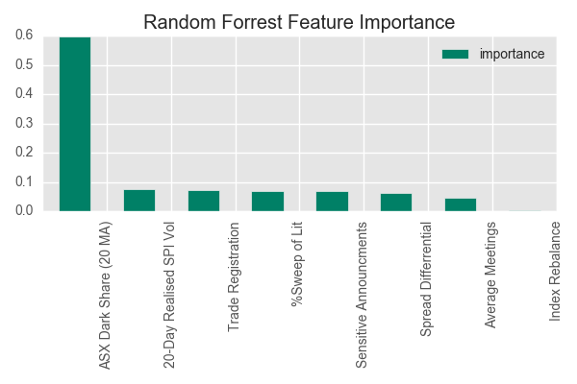

Slide 24
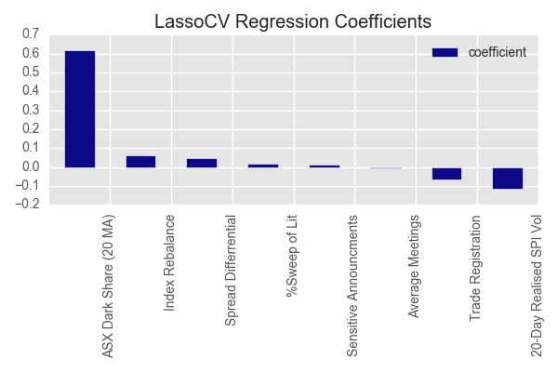
R Squared : 0.54

Slide 25
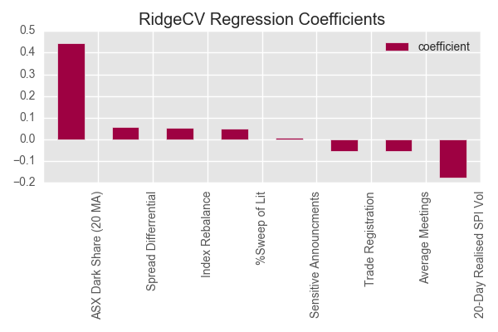
R Squared : 0.52

Slide 26
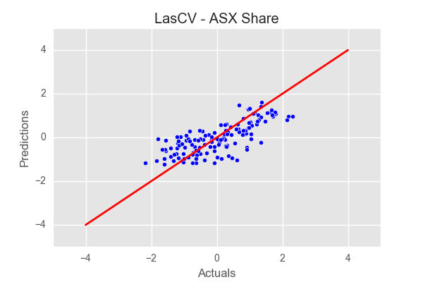
Scatter Line (Las CV) : Predictions = 0.51*(Actuals) + 0.05

Slide 27
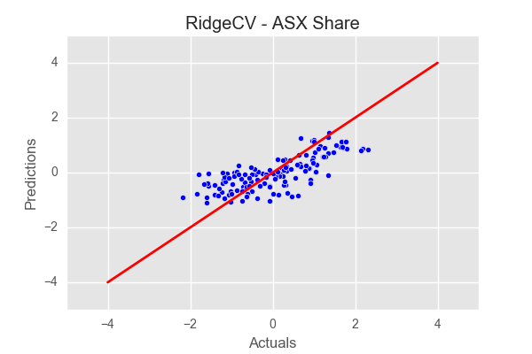
Scatter Line (Ridge CV) : Predictions = 0.44*(Actuals) + 0.04

